Slide 1
Neuromancer: Differentiable Programming Library for Modeling, Control, and Optimization
INFORMS, Phoenix, Arizona
Ján Drgoňa

Slide 2

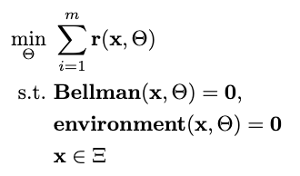

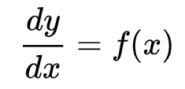

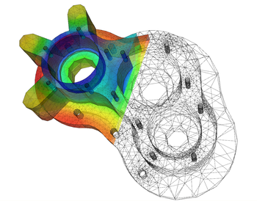
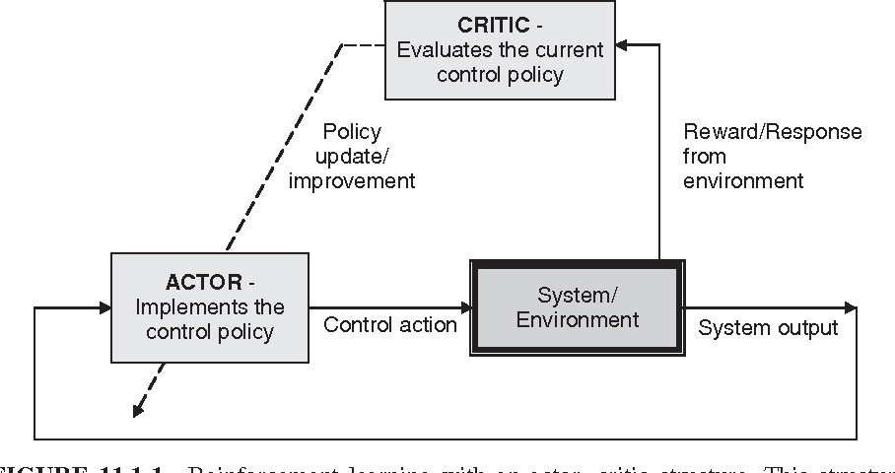

Landscape of Solution Methods
Constrained optimization
Differential equations
Supervised Learning
Reinforcement Learning
Requires prior knowledge of objective function and constraints
Requires prior knowledge of the physics to be modeled
Requires large labeled datasets
Requires environment model to sample
More domain knowledge
Less domain knowledge

Slide 3





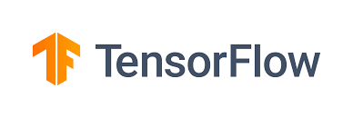










Landscape of Solution Tools
Online optimization
Differential Equations
Supervised Learning
Reinforcement Learning
What comes next? … Differentiable programming (DP): a unifying approach for data-driven modeling and optimization of complex systems based on automatic differentiation (AD)

Slide 4
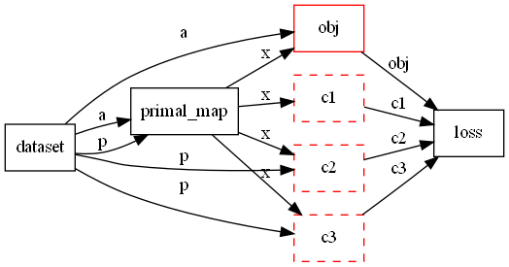
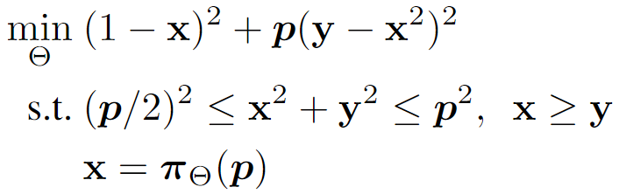
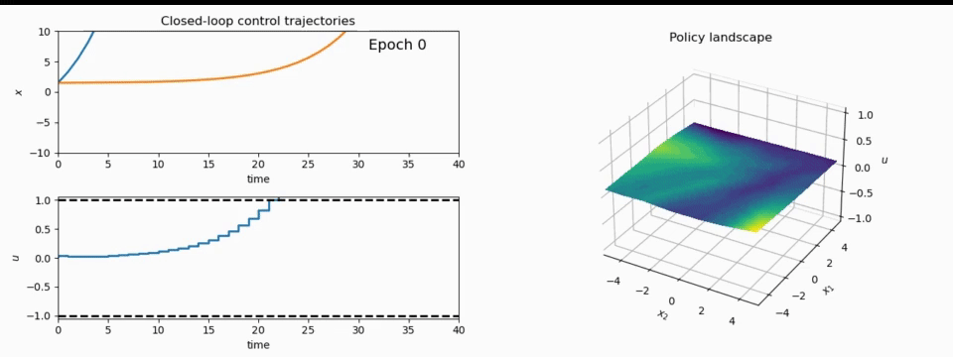
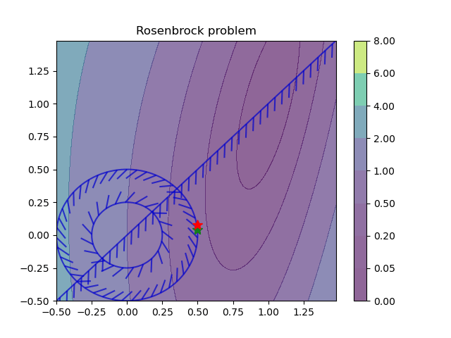
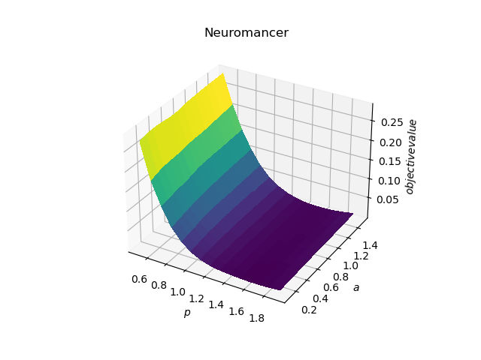
NeuroMANCER: a Scientific Machine Learning Library
1. Mathematical formulation
3. Problem graph
map
2. Python code interface
4. Results
import neuromancer as nm
p = nm.variable(‘p’)
x = nm.variable(‘x’)
y = nm.variable('y’)
obj = ((1-x)**2 + p*(y-x**2)**2).minimize(weight=1.0, name='obj’) c1 = (p/2)**2 <= x**2 + y**2
c2 = x**2 + y**2 <= p**2
c3 = x >= y net = nm.MLP(insize=2, outsize=2, hsizes=[80]*4) map = nm.Node(net, input_keys=['p’], output_keys=[‘x’,‘y’])
loss = nm.PenaltyLoss([obj], [c1, c2, c3]) problem = nm.Problem([map], loss)
optimizer = torch.optim.AdamW(problem.parameters()) trainer = nm.Trainer(problem,data,optimizer)
best_model = trainer.train()

Slide 5



NeuroMANCER
Open-source scientific machine learning (SciML) toolbox in PyTorch for integrating deep learning, constrained optimization, and physics-based modeling
Physics-informed machine learning
Data-driven modeling of dynamical systems
Model-based policy optimization
Parametric constrained optimization
github.com/pnnl/neuromancer

